Slide 1

Lecture 3 Threads and Locks
Distributed Systems
Semester 1 2022/2023
Dr. Ayman Khallel

Slide 2
Content
Process
Threads
Multithreading
Locks
Synchronization
Deadlock
Summary

Slide 3
What is a Process?
Traditionally, a process is considered an instance of a computer program that is being executed.
A process contains
System resources: program code, user data, buffers, devices, I/O channels, files
Current activity: CPU, registers, state, execution path, “On the clock”, interleaved with other processes
Can resources and CPU activity be treated independently
Unit of resource ownership → process or task
Unit of execution → thread or lightweight process

Slide 4
Processes (Heavy)
Resources owned by a process:
code ("text"),
data (VM),
stack,
heap,
files,
tables (signals, semaphores, buffers, I/O,…)
Context switching processes has a significant amount of overhead:
Tables have to be flushed from the processor when context switching.
Processes share information only through pipes and shared memory (IPC).

Slide 5
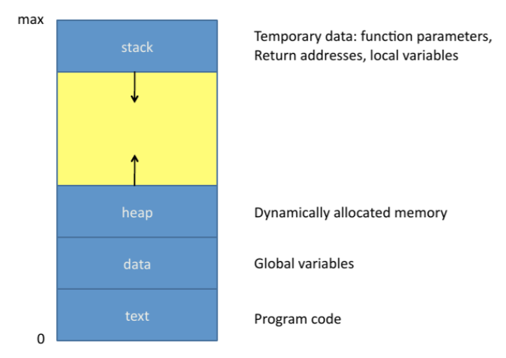
Process
Associated address space
Program itself (text section)
Program’s data (data section)
Stack, heap

Slide 6
What is a Thread?
A thread of execution
Smallest unit of processing (context) that can be scheduled by an operating system
Threads reduce overhead by sharing the resources of a process.
Switching can happen more frequently and efficiently.
Sharing information is not so "difficult" anymore - everything can be shared.
A Thread is an independent program counter and stack operating within a process.
Sometimes called a lightweight process (LWP)
A smaller execution unit than a process.

Slide 7

Thread concepts
Basic unit of CPU utilization
Flow of control within a process
A thread includes
Thread ID Program counter
Register set
Stack
Shares resources with other threads within the same process
Text section
Data section
Other OS resources (open files, ...)

Slide 8
Thread concepts
Multiple threads on multiple CPUs
Multiple threads sharing a single CPU
*Source: Liang, Introduction to Java Programming, Seventh Edition

Slide 9
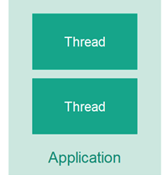
Multithreading
Multiple threads of execution inside the same application.
A thread is like a separate CPU executing your application.
Thus, a multithreaded application is like an application that has multiple CPUs executing different parts of the code at the same time.
Multithreading is a technique that allows for concurrent (simultaneous) execution of two or more parts of a program for maximum utilization of a CPU
basic example - multithreading allows you to write code in one program and listen to music in another

Slide 10
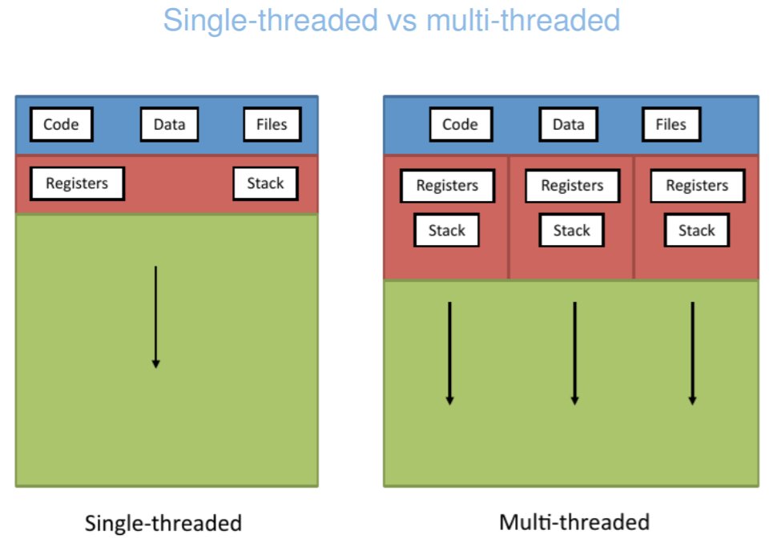

Slide 11
Multithreading example
Think about a single processor running your programming language IDE
You are executing the code that process (read) a large image to be (recognized) using some deep learning algorithm
This process is expensive and may took lots of memory and time dealing with the IO
At this time, the UI may freeze if there is no thread. However, with IO is still in process, IO thread switched out and give to UI that the IDE and the computer is still responsive and not frozen.
This is multitasking in concept – where each thread allocated with a time to be executed on CPU – and switching is very fast (new multicore machine nowadays)

Slide 12

Why multithreading?
Multiple threads in a single core would have to switch back and forth to give the illusion of multitasking – not efficient
In multiple cores – multithreading has become extremely important in terms of the efficiency of your application
common reasons for multithreading are
Better utilization of a single CPU.
Better utilization of multiple CPUs or CPU cores.
Better user experience with regards to responsiveness.
Better user experience with regards to fairness.
Notes:
Multithreading is a type of computer processing in which multiple threads, or threads of execution, run concurrently within a single program or process. This allows a program to perform multiple tasks at the same time, making the most efficient use of the available resources on a computer. In a multithreaded program, each thread has its own set of instructions and can run independently of the other threads, allowing for parallel processing and improved performance

Slide 13
Cost of Multithreading
Performance overhead:
Synchronization
Access to shared resources
Hazards:
Deadlocks: A thread enters a waiting state for a resource held by another one, which in turn is waiting for a resource by another (possible the first one).
Race conditions: Two or more threads read/write shared data and the result depends on the actual sequence of execution of the threads.
Not deterministic: Harder to debug (hard to reproduce errors)
Notes:
In computing, a deadlock is a situation in which two or more threads or processes are blocked, waiting for one another to release a resource that they need in order to continue. This can happen when each thread or process holds a resource that the other needs, and they are unable to proceed without first releasing the resource they are holding. As a result, they remain stuck in a waiting state, unable to make progress. Deadlocks can be a major problem in multithreaded and multiprocessing environments, and they can be difficult to detect and resolve.

Slide 14
Synchronization
Concurrent access to shared data can result in data inconsistency.
To ensure orderly execution of processes, the operating system provides mechanisms for job synchronization and communication.
A deadlock state is a state of indefinite wait by one or more processes for an event that can be triggered only by one of the waiting processes.
Operating system also provides mechanisms to ensure that jobs do not get stuck in a deadlock, forever waiting for each other.
Notes:
Synchronization is a technique used in computer programming to ensure that two or more threads or processes access shared data or resources in a controlled and consistent manner. This is necessary to avoid conflicts, data corruption, and other problems that can arise when multiple threads or processes try to access the same data or resources at the same time. Synchronization is typically achieved using locks, semaphores, or other mechanisms that control the access of threads or processes to shared data or resources. By using synchronization, it is possible to ensure that shared data and resources are accessed in a consistent and orderly manner, allowing multiple threads or processes to work together without conflicts or errors.

Slide 15
Synchronization - Example
Consider two threads t1 and t2:
Thread t1 increments the counter
counter := counter + 1
Thread t2 decrements the counter
counter := counter – 1
If both are run one after the other, the final value of the counter (counter could be a memory location for example) should remain the same regardless of the order in which they are run. One increments it, the other decrements it. No change.
The increment and decrement statements of t1 and t2 translate to machine code as shown on the following slide.

Slide 16
Synchronization - Example
t1 (increment)
reg₁ := counter
reg₁ := reg₁ +1
counter := reg₁
t2 (decrement)
4. reg₂ := counter
5. reg₂ := reg₂ –1
6. counter := reg₂

Slide 17
Synchronization - Example
Consider the situation in which the statements are run in the following order: 1, 2, 3, 4, 5, 6.
The corresponding sequence of code thus, becomes:
1. reg₁ := counter
2. reg₁ := reg₁ + 1
3. counter := reg₁
4. reg₂ := counter
5. reg₂ := reg₂ – 1
6. counter := reg₂
1. reg₁ := 5
2. reg₁ := 5 + 1
3. counter := 6
4. reg₂ := 6
5. reg₂ := 6 – 1
6. counter := 5
Counter =5

Slide 18
Synchronization - Example
Now consider the two threads run concurrently. Consider the situation in which the statements are run in the following order: 1, 2, 4, 3, 5, 6.
The corresponding sequence of code thus, becomes:
1. reg₁ := counter
2. reg₁ := reg₁ + 1
4. reg₂ := counter
3. counter := reg₁
5. reg₂ := reg₂ – 1
6. counter := reg₂
1. reg₁ := 5
2. reg₁ := 5 + 1
4. reg₂ := 5
3. counter := 6
5. reg₂ := 5 – 1
6. counter := 4
Counter =5

Slide 19
Synchronization - An Example
Thus, we see from the preceding sequence of code that the counter will not be unchanged upon completion but will be rather decremented by 1.
The above stated problem arose because both sections of code constitute critical sections and these critical sections interleaved. The critical sections must be run atomically.

Slide 20
Critical Section and Race Condition
A Critical Section is a part of a thread that accesses shared resources. Two threads should not be allowed to enter their critical sections at the same time, thus preventing the above problem.
The situation where several threads access and manipulate the same data concurrently, and the outcome of the execution depends on the particular order in which the access takes place, is called a race condition.

Slide 21
Thread Synchronization More on Critical Section
Important points to note about critical sections:
A critical section must be run atomically.
This means that the section is executed either as a whole or not at all. Once the critical section of a process begins, it must be completed or rolled back.
Mutual exclusion of more than one critical section must be ensured
Mutual exclusion is ensured by using pieces of code to block a thread that attempts to run its critical section while the critical section of another thread is being executed. The thread is unblocked when the other thread’s critical section completes execution. This is known as Sleep and Wakeup.

Slide 22
Synchronization with lock
When two or more operations belonging to concurrent threads try to access the shared memory, a race condition can occur.
The easiest way to get around the race conditions is the use of a lock.
The operation of a lock is simple when a thread wants to access a portion of shared memory, it must necessarily acquire a lock on that portion prior to using it.
After completing its operation, the thread must release the lock that was previously obtained.
The impossibility of incurring races is critical as the need of the lock for the thread.
Notes:
A race condition is a situation in which two or more threads or processes access shared data and try to change it at the same time. Because the threads or processes are not synchronized, the resulting behavior is unpredictable and can lead to errors.

Slide 23
Advantages of lock
It allows us to restrict the access of a shared resource to a single thread or a single type of thread at a time
Before accessing the shared resource of the program, the thread must acquire the lock and must then allow any other threads access to the same resource.
There are two methods that are used to manipulate the locks: acquire() and release()
Concurrently means happening at the same time. In the context of computing, concurrency refers to the ability of a system to support multiple threads or processes that can be executed simultaneously. This can be useful for improving the performance and responsiveness of a system by allowing different tasks to be performed in parallel, rather than sequentially.
Notes:
The primary advantage of using a lock is that it can help prevent race conditions by ensuring that only one thread can access a shared resource at a time. This can help ensure the integrity of the shared data and avoid errors that may result from multiple threads trying to modify the data simultaneously. Locks can also help improve the performance of multi-threaded programs by allowing threads to run concurrently and avoid unnecessary delays. In addition, locks can provide a simple and effective mechanism for synchronizing access to shared resources, which can make it easier to write and maintain multi-threaded programs.

Slide 24
Disadvantages of lock
Subject to harmful situations of deadlock
Limits the scalability of the code and its readability
The use of a lock is in conflict with the possible need to impose the priority of access to the memory shared by the various processes.
Difficulties find errors.

Slide 25
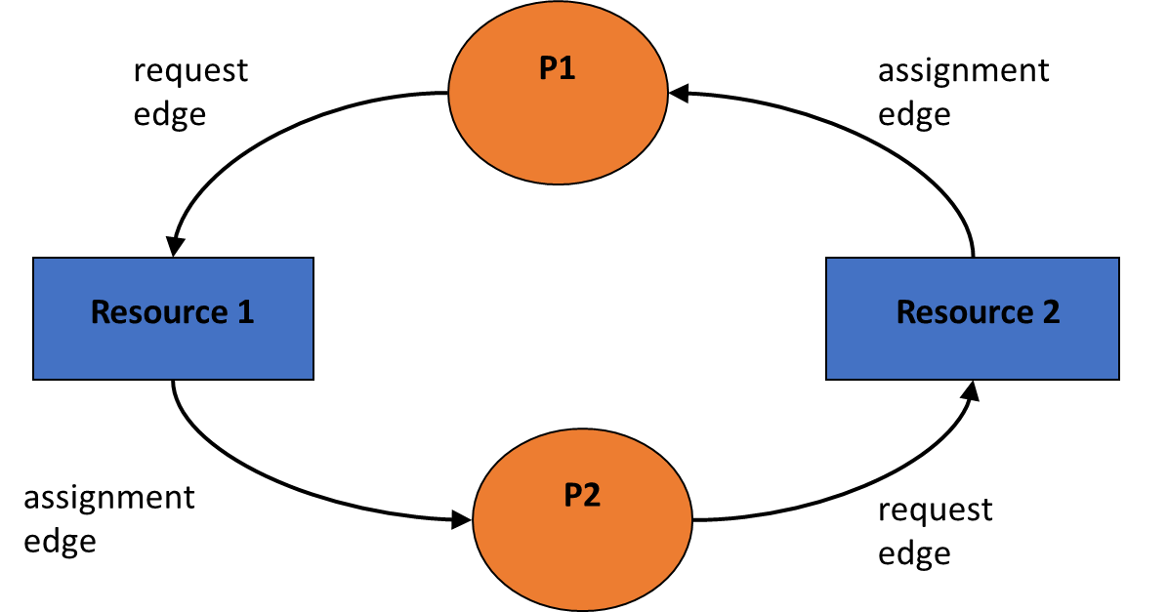
Deadlock
T1
A deadlock occurs due to the acquisition of a lock from different threads
It is impossible to proceed with the execution of operations
Let’s think of a situation wherein there are two concurrent threads
T2

Slide 26
Deadlocks The four necessary conditions
The four necessary conditions for a deadlock to occur are:
Mutual exclusion of resources
Inability of a resource to be used by more than one thread
Hold-and-wait
A thread holds a resource while waiting for another one
No pre-emption
The system is incapable of grabbing a resource from a thread
Circular Wait

Slide 27

Deadlock Handling Four methods for handling deadlocks
The four method for dealing with the deadlock problem are:
Prevention
Detection and Recovery
Avoidance
Ignoring the condition
Ignoring deadlocks is by far the most widely used method.

Slide 28
References
Madhavan Nagarajan. Concurrency vs. Parallelism — A brief view.
http://tutorials.jenkov.com/java-concurrency/concurrency-vs-parallelism.html
https://www.educative.io/blog/multithreading-and-concurrency-fundamentals
Umakishore Ramachandran and William D. Leahy Jr., Multithreaded Programming and Multiprocessors
Prof. Paolo Bientinesi and Diego Fabregat-Traver. Parallel Programming Processes and Threads.
https://www.tutorialspoint.com/java/java_thread_deadlock.htm
Notes:
3:25

Slide 29

Thank You
Next: Functional Parallelism and Concurrency

